Slide 1
Image Manipulation and Storage

Slide 2
Contents
What is an Image? Digital image file formats, Image compression standard – JPEG, Image Processing - Digital image enhancement, contrast stretching, Histogram Equalization, smoothing and median Filtering.

Slide 3
What is an Image? Digital image file formats
An image is a visual representation of something
The term has several usages:
An image is a picture that has been created or copied and stored in electronic form.
An image can be described in terms of vector graphics or raster graphics.
An image stored in raster form is sometimes called a bitmap.
An image map is a file containing information that associates different locations on a specified image with hypertext links.

Slide 4
Image Formats
Image Format describes how data related to the image will be stored. Data can be stored in compressed, Uncompressed or vector format. Each format of the image have a different advantage and disadvantage. Image types such a TIFF are good for printing while JPG or PNG, are best for web.
TIFF(.tif, .tiff)
JPEG (.jpg, .jpeg)
GIF (.gif)
PNG (.png)
Bitmap (.bmp)
EPS (.eps)
RAW Image Files (.raw, .cr2, .nef, .orf, .sr2)

Slide 5
What is meant by image saved with transparency?
Image saved with transparency look good on colored background whereas image without transparency will have a white background which will be visible on colored background.

Slide 6
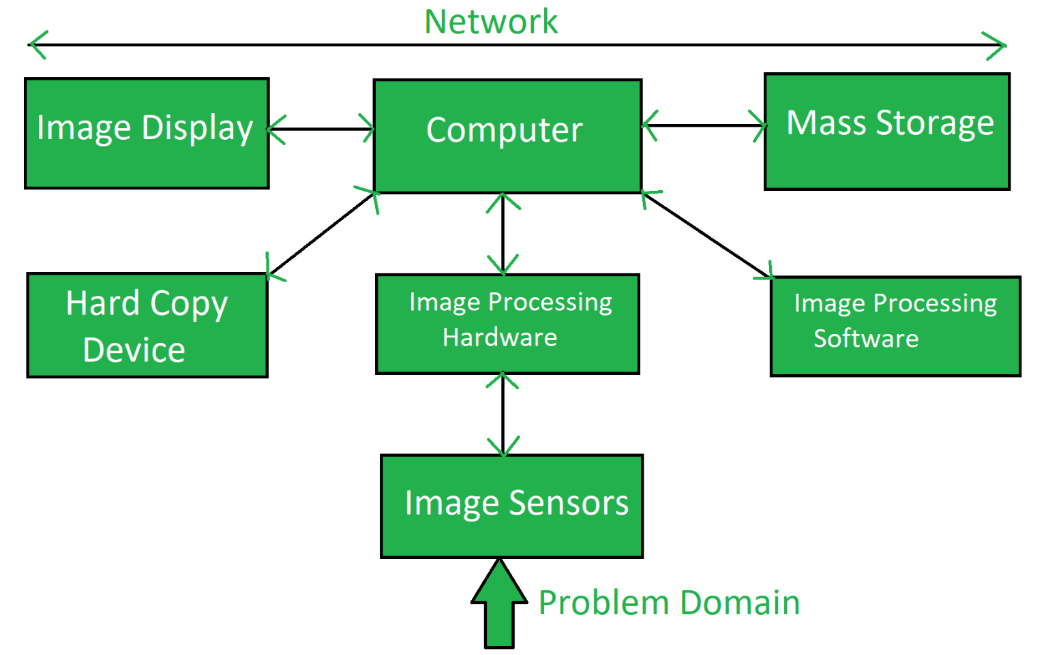
Components of Image Processing System

Slide 7
Digital Image Processing
Introduction
Motivation and perspective
Application

Slide 8
Digital Image processing
Digital Image Processing means processing digital image by means of a digital computer. We can also say that it is a use of computer algorithms, in order to get enhanced image either to extract some useful information.
Image processing mainly include the following steps:
1.Importing the image via image acquisition tools; 2.Analysing and manipulating the image; 3.Output in which result can be altered image or a report which is based on analysing that image.

Slide 9
Image Enhancement
Introduction
Spatial domain techniques
Point operations
Histogram equalization and matching
Applications of histogram-based enhancement
Frequency domain techniques
Unsharp masking
Homomorphic filtering*

Slide 10
IMAGE ENHANCEMENT
Point-wise operations
Contrast enhancement; contrast stretching
Grey scale clipping; image binarization (thresholding)
Image inversion (negative)
Grey scale slicing
Bit extraction
Contrast compression
Image subtraction
Histogram modeling: histogram equalization/ modification

Slide 11
Spatial operations
Spatial low-pass filtering.
Spatial high-pass and band-pass filtering
Inverse contrast ratio mapping and statistical scaling
Magnification and interpolation (image zooming)
Examples of image enhancement operations:
noise removal;
geometric distortion correction;
edge enhancement;
contrast enhancement;
image zooming;
image subtraction.

Slide 12
Recall:
There is no boundary of imagination in the virtual world
In addition to geometric transformation (warping) techniques, we can also photometrically transform images
Ad-hoc tools: point operations
Systematic tools: histogram-based methods
Applications: repair under-exposed or over-exposed photos, increase the contrast of iris images to facilitate recognition, enhance microarray images to facilitate segmentation.

Slide 13
Point Operations Overview
Point operations are zero-memory operations where
a given gray level x[0,L] is mapped to another
gray level y[0,L] according to a transformation
y
L
x
L
L=255: for grayscale images

Slide 14
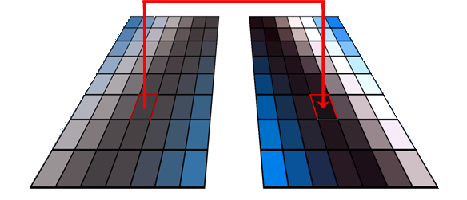
A. Point-wise operations
Def.: The new grey level (color) value in a spatial location (m,n) in the resulting image depends only on the grey level (color) in the same spatial location (m,n) in the original image
=> “point-wise” operation, or grey scale transformation (for grey scale images).
U[M×N]
V[M×N]
m
m
n
n
Point-wise operation
(grey scale transformation)
f(∙) => v=f(u)
u(m,n)
v(m,n) = f(u(m,n))

Slide 15
Lazy Man Operation
y
L
x
L
No influence on visual quality at all

Slide 16
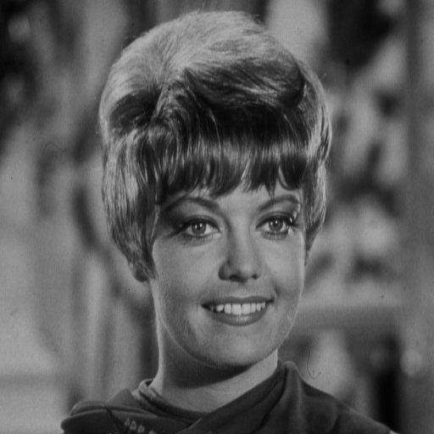
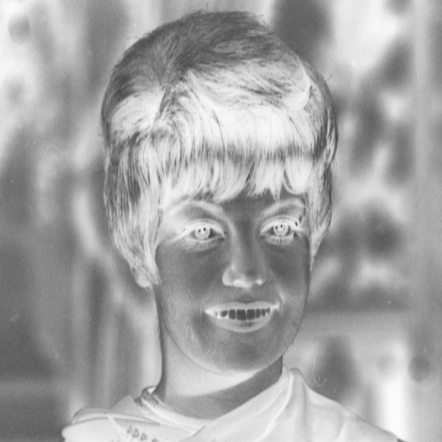
Digital Negative
L
x
0
L

Slide 17
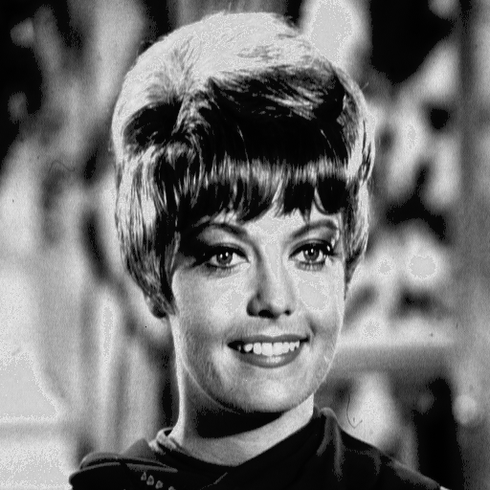
Contrast Stretching
y_{b}
y_{a}
a
b
x
0
L

Slide 18
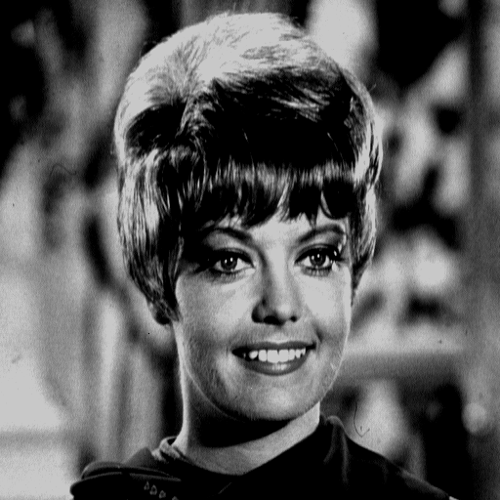
Clipping
a
b
x
0
L

Slide 19
Grey scale clipping; image thresholding
Grey scale clipping is a particular case of contrast enhancement, for m=p=0:

Slide 20
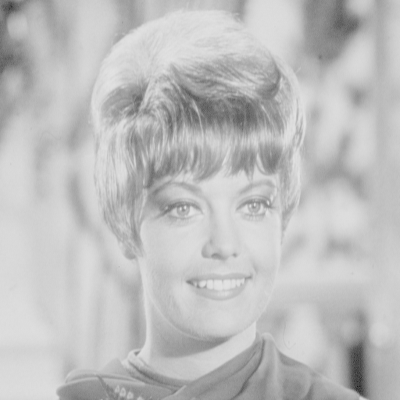
Range Compression
x
0
L
c=100

Slide 21
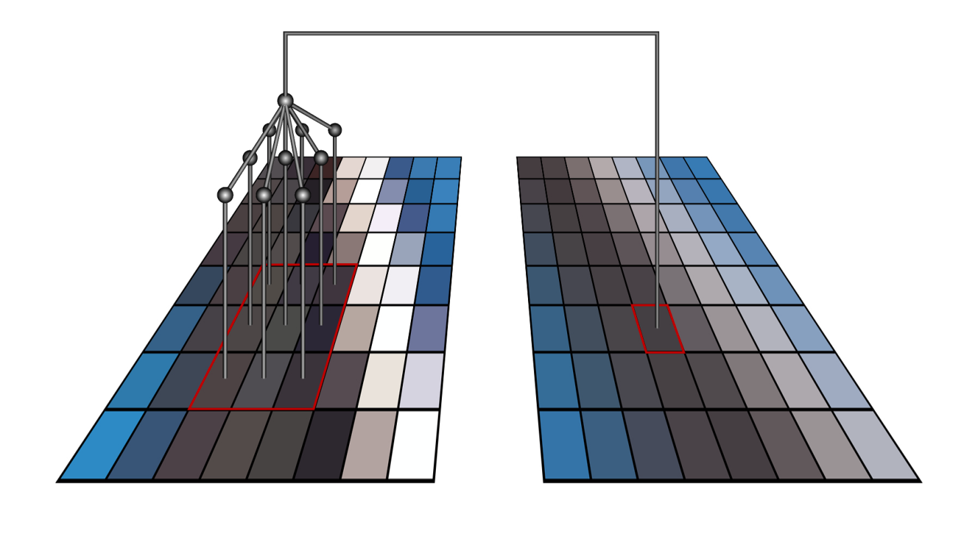
SPATIAL OPERATIONS: most of them can be implemented by convolution
- Convolution mask
A_{M}

Slide 22
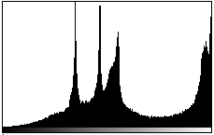
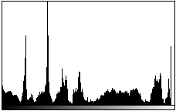
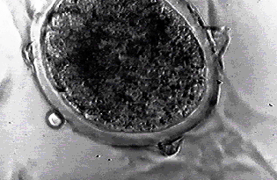
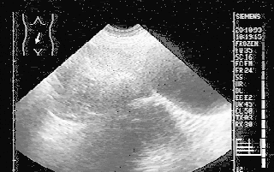
Histogram equalization and pseudo-coloring in biomedical images:

Slide 23
Summary of Point Operation
So far, we have discussed various forms of mapping function f(x) that leads to different enhancement results
MATLAB function >imadjust
The natural question is: How to select an appropriate f(x) for an arbitrary image?
One systematic solution is based on the histogram information of an image
Histogram equalization and specification

Slide 24
Histogram based Enhancement
Histogram of an image represents the relative frequency
of occurrence of various gray levels in the image
MATLAB function >imhist(x)

Slide 25
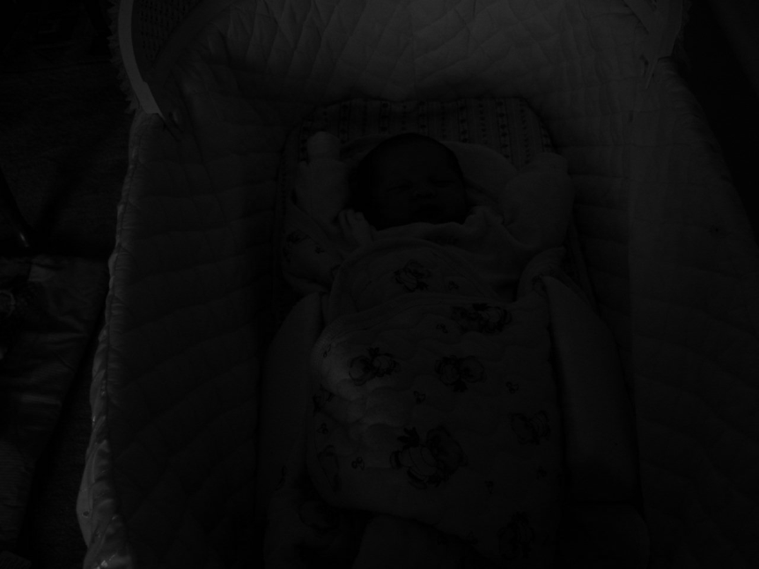
Why Histogram?
It is a baby in the cradle!
Histogram information reveals that image is under-exposed

Slide 26
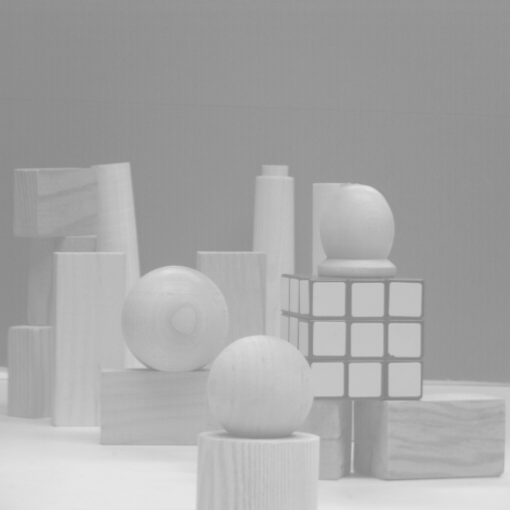
Another Example
Over-exposed image

Slide 27
How to Adjust the Image?
Histogram equalization
Basic idea: find a map f(x) such that the histogram of the modified (equalized) image is flat (uniform).
Key motivation: cumulative probability function (cdf) of a random variable approximates a uniform distribution
Suppose h(t) is the histogram (pdf)

Slide 28
Histogram Equalization
Uniform
Quantization
Note:
y
cumulative probability function
L
1
x
0
L

Slide 29
MATLAB Implementation
function y=hist_eq(x)
[M,N]=size(x);
for i=1:256
h(i)=sum(sum(x= =i-1));
End
y=x;s=sum(h);
for i=1:256
I=find(x= =i-1);
y(I)=sum(h(1:i))/s*255;
end
Calculate the histogram
of the input image
Perform histogram
equalization

Slide 30
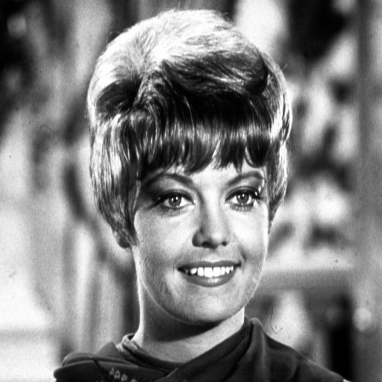
Image Example
before
after

Slide 31
Histogram Comparison
before equalization
after equalization

Slide 32
Adaptive Histogram Equalization

Slide 33
Histogram Specification/Matching
Given a target image B, how to modify a given image A such that
the histogram of the modified A can match that of target image B?
histogram₁
histogram₂
S⁻¹*T
T
S
?

Slide 34
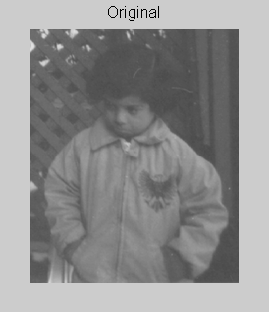
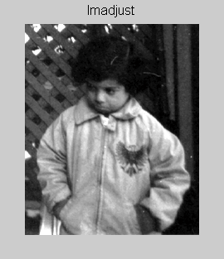
Application (I): Digital Photography

Slide 35
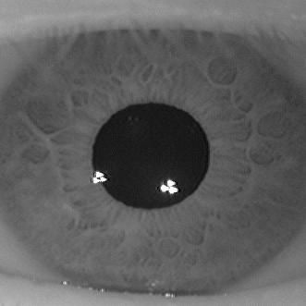
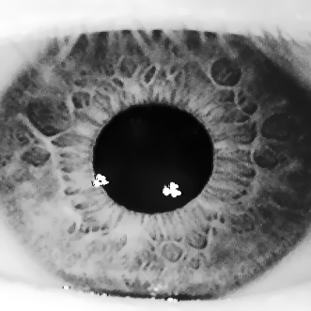
Application (II): Iris Recognition
before
after

Slide 36
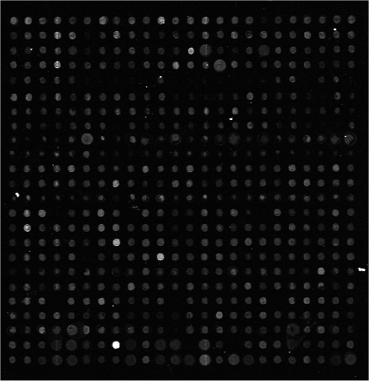
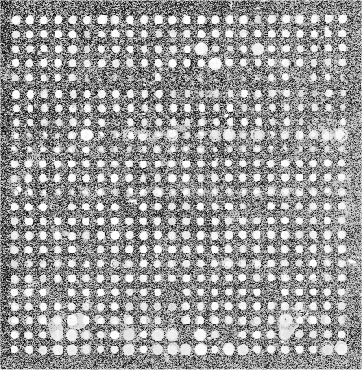
Application (III): Microarray Techniques
before
after

Slide 37
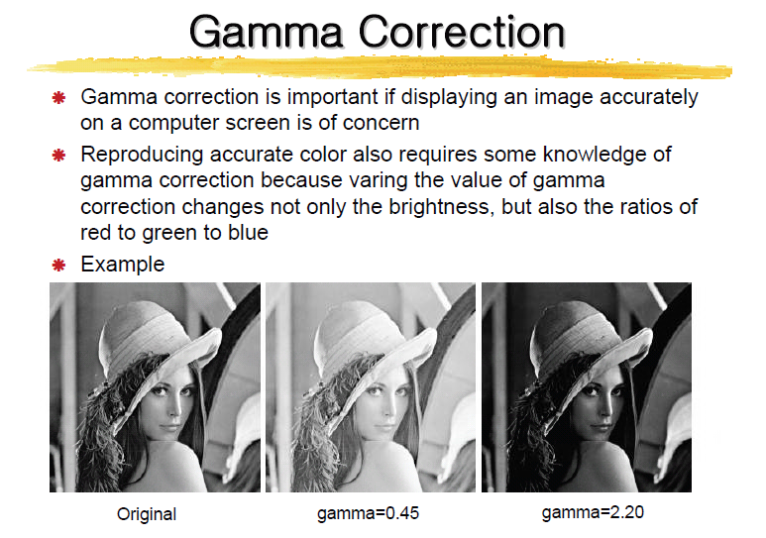
Application (IV)

Slide 38
Image Enhancement
Introduction
Spatial domain techniques
Point operations
Histogram equalization and matching
Applications of histogram-based enhancement
Frequency domain techniques
Unsharp masking
Homomorphic filtering*

Slide 39
Frequency-Domain Techniques (I): Unsharp Masking
g(m,n) is a high-pass filtered version of x(m,n)
• Example (Laplacian operator)

Slide 40
MATLAB Implementation
% Implementation of Unsharp masking
function y=unsharp_masking(x,lambda)
% Laplacian operation
h=[0 -1 0;-1 4 -1;0 -1 0]/4;
dx=filter2(h,x);
y=x+lambda*dx;

Slide 41
1D Example
x(n)
x_{lp}(n)
g(n)=x(n)-x_{lp}(n)

Slide 42
Frequency-Domain Techniques (II): Homomorphic filtering
Basic idea:
Illumination
(low freq.)
reflectance
(high freq.)
freq. domain enhancement

Slide 43
Summary of Nonlinear Image Enhancement
Understand how image degradation occurs first
Play detective: look at histogram distribution, noise statistics, frequency-domain coefficients…
Model image degradation mathematically and try inverse-engineering
Visual quality is often the simplest way of evaluating the effectiveness, but it will be more desirable to measure the performance at a system level
Iris recognition: ROC curve of overall system
Microarray: ground-truth of microarray image segmentation result provided by biologists

Slide 44
Spatial Image Enhancement Techniques: Image Averaging
A noisy image:
Averaging M different noisy images:

Slide 45
Image Averaging
As M increases, the variability of the pixel values at each location decreases.
This means that g(x,y) approaches f(x,y) as the number of noisy images used in the averaging process increases.
Registering of the images is necessary to avoid blurring in the output image.

Slide 46
Local Enhancement
When it is necessary to enhance details over smaller areas
To devise transformation functions based on the gray-level distribution in the neighborhood of every pixel

Slide 47
Local Enhancement
The procedure is:
Define a square (or rectangular) neighborhood and move the center of this area from pixel to pixel.
At each location, the histogram of the points in the neighborhood is computed and either a histogram equalization or histogram specification transformation function is obtained.

Slide 48
Local Enhancement
More procedure:
This function is finally used to map the grey level of the pixel centered in the neighborhood.
The center is then moved to an adjacent pixel location and the procedure is repeated.

Slide 49
Frequency Domain Filters
Low-pass filters eliminate or attenuate high frequency components in the frequency domain (sharp image details), and result in image blurring.
High-pass filters attenuate or eliminate low-frequency components (resulting in sharpening edges and other sharp details).
Band-pass filters remove selected frequency regions between low and high frequencies (for image restoration, not enhancement).

Slide 50
Spatial Filtering
Use of spatial masks for image processing (spatial filters)
Linear and nonlinear filters
Mean Filter:
Linear spatial filter is simply the average of the pixels contained in the neighborhood of the filter mask. The idea is replacing the value of every pixel in an image by the average of the grey levels in the neighborhood define by the filter mask.
Types of Mean filter:
(i) Averaging filter: It is used in reduction of the detail in image. All coefficients are equal.
(ii) Weighted averaging filter: In this, pixels are multiplied by different coefficients. Center pixel is multiplied by a higher value than average filter.

Slide 51
Spatial Filtering
a=(m-1)/2 and b=(n-1)/2,
m x n (odd numbers)
For x=0,1,…,M-1 and y=0,1,…,N-1
Also called convolution (primarily in the frequency domain)

Slide 52
Spatial Filtering
The basic approach is to sum products between the mask coefficients and the intensities of the pixels under the mask at a specific location in the image:
(for a 3 x 3 filter)

Slide 53
Spatial Filtering
Non-linear filters also use pixel neighborhoods but do not explicitly use coefficients
e.g. noise reduction by median gray-level value computation in the neighborhood of the filter
These method can be carried out in both frequency domain and spatial domain.

Slide 54
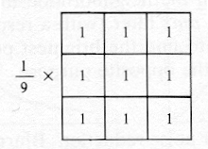
Smoothing Filters
Used for blurring (removal of small details prior to large object extraction, bridging small gaps in lines) and noise reduction.
Low-pass (smoothing) spatial filtering
Neighborhood averaging
- Results in image blurring

Slide 55
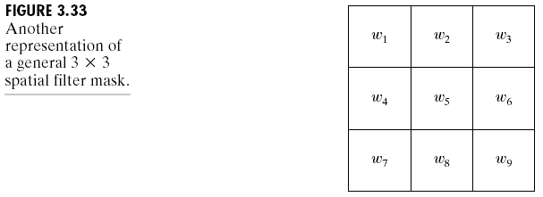
Image Enhancement in the
Spatial Domain

Slide 56
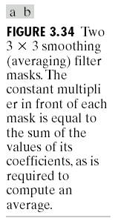
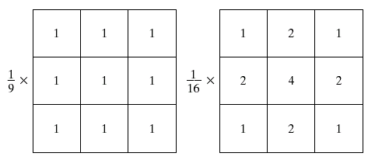
Image Enhancement in the
Spatial Domain

Slide 57
Smoothing Filters
Median filtering (nonlinear)
Used primarily for noise reduction (eliminates isolated spikes)
The gray level of each pixel is replaced by the median of the gray levels in the neighborhood of that pixel (instead of by the average as before).

Slide 58
Image Sharpening
Image sharpening deals with enhancing detail information in an image.
The detail information is typically contained in the high spatial frequency components of the image.
Therefore, most of the techniques contain some form of highpass filtering.

Slide 59
Image Sharpening
Highpass filtering can be done in both the spatial and frequency domain.
Spatial domain: using convolution mask (e.g. enhancement filter).
Frequency domain: using multiplication mask.
However, highpass filtering alone can cause the image to lose its contrast.

Slide 60
Image Sharpening
This problem can be solved using high-frequency emphasis filter, which retains some low-frequency information.
A similar result can be obtained in spatial domain using a high boost spatial filter.

Slide 61
Image Sharpening
The filtering is done by convolving the mask with the image.
The value x determines the amount of low-frequency information retained in the resulting image.
If x = 8 → pure highpass filter
If x < 8 → results in a negative of the original
If x > 8 → retain some low frequency information

Slide 62
Image Sharpening
In general, the larger the value of x is, the more low-frequency information is retained.
A larger mask will emphasize the edges more (make them wider), but help to reduce the noise effect.
If we create an N x N mask, the value for x for a highpass filter is N x N –1.

Slide 63
Homomorphic Filtering
The digital images are created from optical image that consist of two primary components:
The lighting component
The reflectance component
The lighting component results from the lighting condition present when the image is captured.
Can change as the lighting condition change.

Slide 64
Homomorphic Filtering
The reflectance component results from the way the objects in the image reflect light.
Determined by the intrinsic properties of the object itself.
Normally do not change.
In many applications, it is useful to enhance the reflectance component, while reducing the contribution from the lighting component.

Slide 65
Homomorphic Filtering
Homomorphic filtering is a frequency domain filtering process that compresses the brightness (from the lighting condition) while enhancing the contrast (from the reflectance properties of the object).
The image model for homomorphic filter is as follows:
I(r,c) = L(r,c)R(r,c)

Slide 66
Homomorphic Filtering
L(r,c) represents contribution of the lighting condition.
R(r,c) represents contribution of the reflectance properties of the object.
The homomorphic filtering process assumes that L(r,c) consists of primarily low spatial frequencies.
Responsible for the overall range of the brightness in the image (overall contrast).

Slide 67
Homomorphic Filtering
The assumptions for R(r,c) are that it consists primarily of high spatial frequency information.
Especially true at object boundaries.
Responsible for the local contrast.
These simplifying assumptions are valid for many types of real images.

Slide 68
Homomorphic Filtering
The homomorphic filtering process consists of five steps:
A natural log transform (base e)
The Fourier transform
Filtering
The inverse Fourier transform
The inverse log function (exponential)

Slide 69
Homomorphic Filtering
The log transform will decouple the L(r,c) and R(r,c) from a multiply into a sum.
The Fourier transform will convert the image into its frequency-domain representation so that filtering can be done.
The typical filter used is a filter similar to a non-ideal high-frequency emphasis filter.

Slide 70
Homomorphic Filtering
There are three parameters to specify:
The high-frequency gain
The low-frequency gain
The cutoff frequency
The high-frequency gain is typically greater than 1, and the low-frequency gain is less than 1.
This would result in boosting the R(r,c) component while reducing the L(r,c) component.

Slide 71
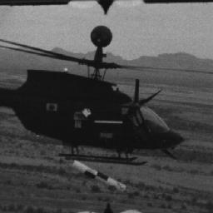
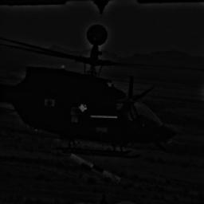
Homomorphic Filtering
Original image
Result of homomorphic filtering – upper gain=1.2; lower gain=0.5; cutoff frequency=16

Slide 72
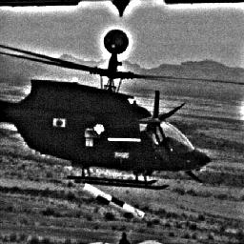
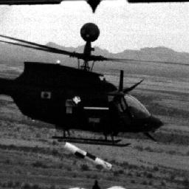
Homomorphic Filtering
Histogram stretch version of original image (without homomorphic filtering)
Histogram stretch applied to result of homomorphic filtering

Slide 73
Unsharp Masking
The unsharp masking enhancement algorithm is one of the more practical image sharpening methods.
It combines many of the operations discussed before, including filtering and histogram modification.
The flowchart of the process is shown in the next slide.

Slide 74
Unsharp Masking
Input Image
Lowpass Filter
Histogram Shrink
Subtract Images
Histogram Stretch
Sharpened Image

Slide 75
Unsharp Masking
The subtraction has the visual effect of causing overshoot and undershoot at the edges, which will emphasize the edges.
By scaling the lowpassed image with a histogram shrink, we can control the amount of edge emphasis desired.
To get more sharpening effect, shrink the histogram less.

Slide 76
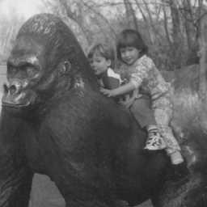
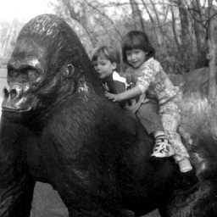
Unsharp Masking
Result of unsharp masking with lower limit = 0, upper limit = 100 and 2% clipping
Original image

Slide 77

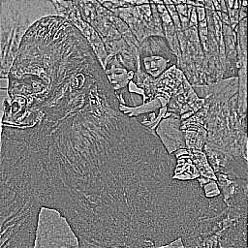
Unsharp Masking
Result of unsharp masking with lower limit = 0, upper limit = 150 and 2% clipping
Result of unsharp masking with lower limit = 0, upper limit = 200 and 2% clipping

Slide 78
Image Smoothing
Image smoothing is used for two primary purposes:
To give an image a softer or special effect
To eliminate noise
In spatial domain, this can be accomplished using various types of mean or median filters.
The main idea is to eliminate any extreme values.

Slide 79
Image Smoothing
A larger mask size would give a greater smoothing effect.
Too much smoothing will eventually lead to blurring.
In the frequency domain, image smoothing is accomplished using a lowpass filter.
All these filters have been discussed previously and will not be discussed here.

